Slide 1
Outer Course Summary

Slide 2
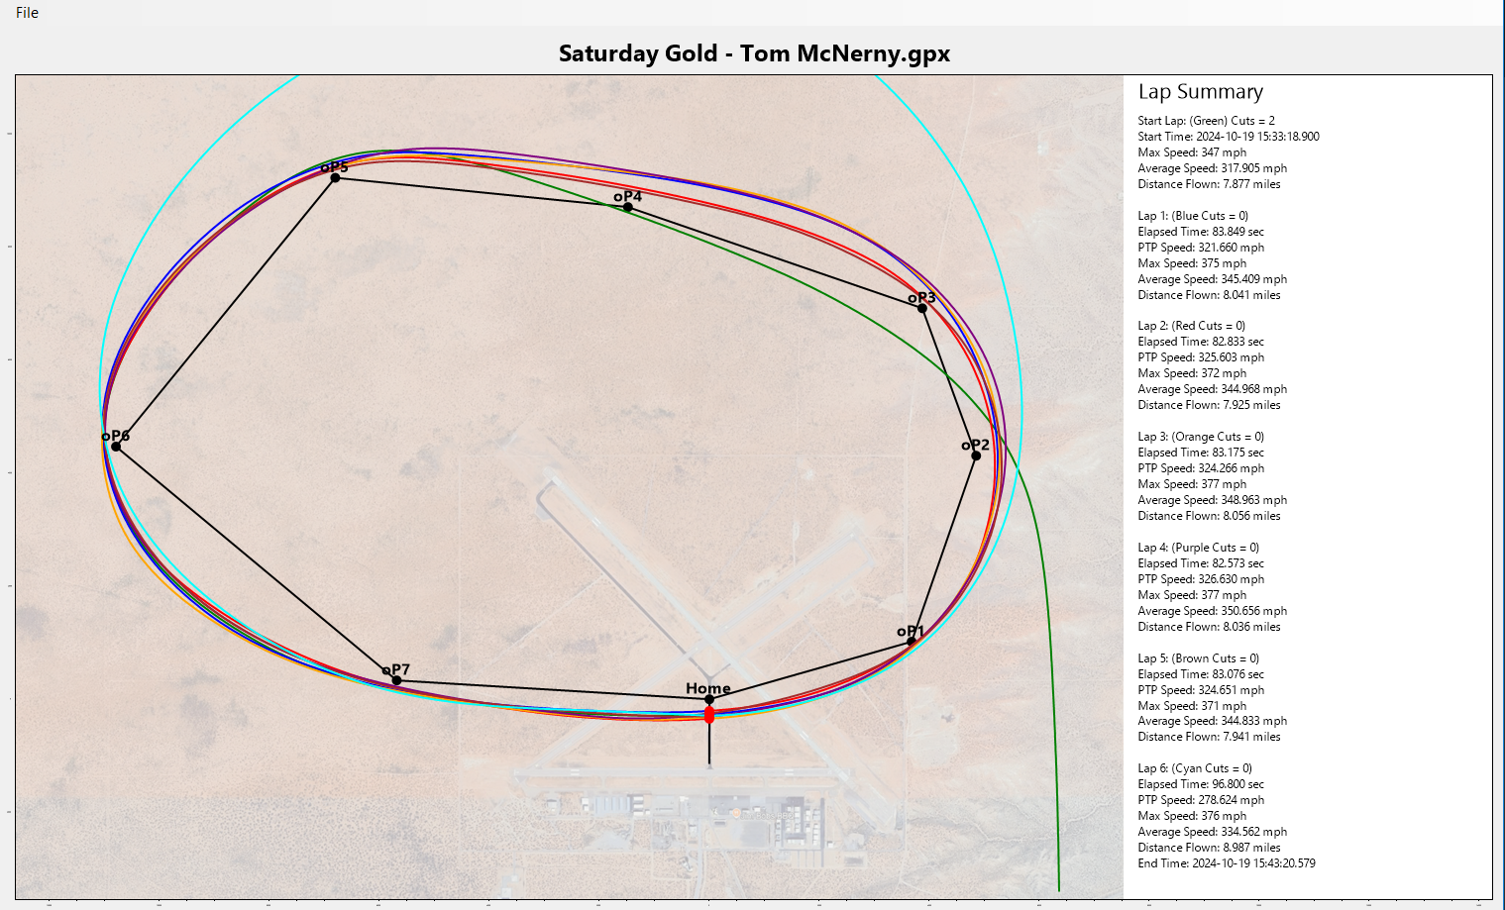

Slide 3
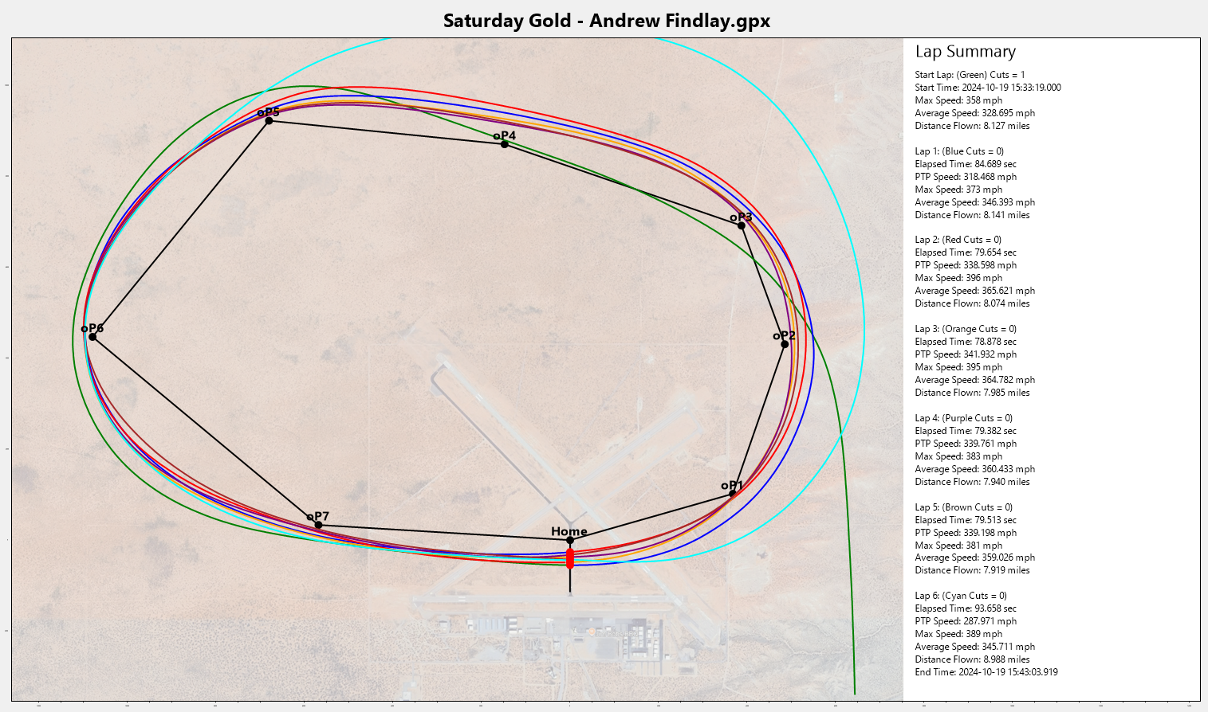

Slide 4
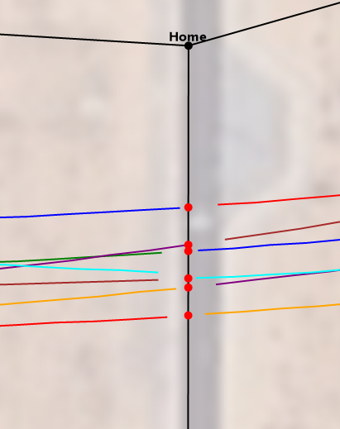
Interpolated crossing, accurate to sub 1ms.

